Slide 1

MINOR PROJECT REPORT ON SUNFLOWER PANEL BACHELOR OF TECHNOLOGY IN MECHATRONICS ENGINEERING
Presented By:
DIVYANSH JAIN [01470211218], NEERAJ JOSHI [02970211218],
NILKANTHA BAG [03070211218], VISHWKANT [04970211218]]

Slide 2
Sunflower Panel
The proposed prototype is based on a dual-axis sunflower panel controlled with Arduino Uno which is an open-source prototyping platform based on easy-to-use hardware and software.
The sunflower panel can be controlled automatically with the help of Light Dependent Resistor (LDR) sensors.
Moreover, this test bench provides virtual instrumentation based on excel in which its sunflower panel data can be recorded and presented. The hardware used has been chosen to be inexpensive, compact and versatile.

Slide 3
Introduction
In this project, we are going to show you how to make an arduino based sunflower panel using LDRs & servo motors. The sunflower panel is designed to follow the sun movement so that maximum light intensity hits on the solar panel, thus increasing the power generation capacity through out the day.
We have designed a dual-axis sun rays tracking panel system. In this system, the whole solar panel moves from east to west in a day to point in the direction of the sun. The use of a sunflower panel circuit in the field of energy production will increase its electricity generation capacity.

Slide 4
Working
LDRs are used as the main light sensors. Two servo motors are fixed to the structure that holds the solar panel. The program for arduino is uploaded to the microcontroller. The working of the project is as follows:-
LDRs sense the amount of sunlight falling on them. Four LDRs are divided into top, bottom, left and right.
For east – west tracking, the analog values from two top LDRs and two bottom LDRs are compared and if the top set of LDRs receive more light, the vertical servo will move in that direction.

Slide 5
If the bottom LDRs receive more light, the servo moves in that direction.
For angular deflection of the solar panel, the analog values from two left LDRs and two right LDRs are compared. If the left set of LDRs receive more light than the right set, the horizontal servo will move in that direction.
If the right set of LDRs receive more light, the servo moves in that direction.

Slide 6
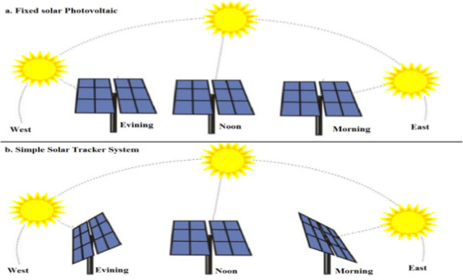
Diagram
Fixed Solar Panel
West
Evening
Noon
Morning
East
Sun Tracking Panel
West
Evening
Noon
Morning
East

Slide 7
Analysis
In the first set of the picture, it can be seen that solar panel will produce maximum amount of electricity in the noon when sun rays are falling directly on the surface.
Where as in the second set of the picture, the sunflower panel will rotate according to the detection of maximum intensity of sun rays.

Slide 8
Components Required:
Arduino Uno Board
Servo Motor SG90
Resistors 10K – 4 Nos
LDR – 4 Nos
Breadboard
Jumper wires(male to female)
5 to 12 Volt power Supply

Slide 9
Arduino UNO
The Arduino Uno is a microcontroller board based on the ATmega328. Arduino is an open source, prototyping platform and its simplicity makes it ideal for hobbyists to use as well as professionals. The Arduino Uno has 14 digital input/output pins (of which 6 can be used as PWM outputs), 6 analog inputs, a 16 MHz crystal oscillator, a USB connection, a power jack, an ICSP header, and a reset button. It contains everything needed to support the microcontroller; simply connect it to a computer with a USB cable or power it with a AC to DC adapter or battery to get started.

Slide 10
Light Dependent Resistor (LDR)
It is a photo-resistor device whose resistivity is a function of the incident electromagnetic radiation. Hence, they are light sensitive devices. They are also called as photo conductors, photo conductive cells or simply photocells.
They are made up of semiconductor materials having high resistance.
LDR works on the principle of photo conductivity. Photo conductivity is an optical phenomenon in which the material’s conductivity is increased when light is absorbed by the material.

Slide 11
Servo Motor
A DC servo motor consists of a small DC motor, feedback potentiometer, gearbox, motor drive electronic circuit and electronic feedback control loop. It is more or less similar to the normal DC motor.
The stator of the motor consists of a cylindrical frame and the magnet is attached to the inside of the frame.
A brush is built with an armature coil that supplies the current to the commutator. At the back of the shaft, a detector is built into the rotor in order to detect the rotation speed.

Slide 12
Solar Panel and Connected Load
The solar panel is a device used to accept the light radiation which is purely controlled by LDR sensors and the load connected depends upon the rating of the panel used.
Solar panel is placed at the top and connected to a load directly. The load may be a LED or a voltmeter which could be connected to get the exact voltage which depends on the intensity of light falling on the panel and the position of the tracker.
Concentrated solar photovoltaics have optics that directly accept sunlight, so solar panel must be angled correctly to collect energy. All concentrated solar systems have trackers because the systems do not produce energy unless directed correctly towards the sun.

Slide 13
Dual axis movement
The dual axis sun tracking panel is device which senses the light and positions towards the maximum intensity of light. It is made in such a way to track the light coming from any direction.
To simulate the general scenario of the Sun’s movement, the total coverage of the movement of the tracker is considered as 120˚ in both the directions.
The initial position of both the servo motors are chosen at 90˚i.e, for east-west servo motor as well as for north-south servo motor.

Slide 14
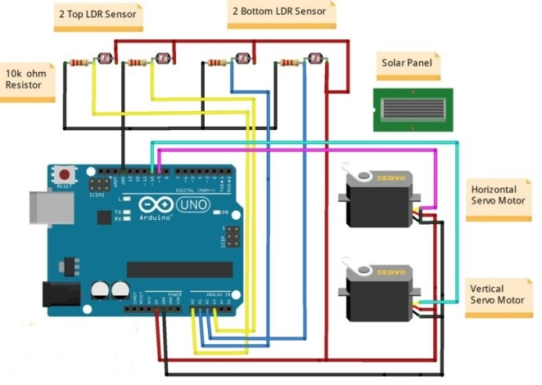
Circuit Diagram

Slide 15
Advantages
Sunflower panels generate more electricity than their stationary counterparts due to increased direct exposure to solar rays. This increase can be as much as 10 to 25% depending on the geographic location of the tracking system.
There can be different kinds of sunflower panel, such as single-axis and dual-axis trackers, all of which can be the perfect fit for a unique jobsite. Installation size, local weather, degree of latitude and electrical requirements are all important considerations that can influence the type of sunflower panel best suited for a specific solar installation.
Sunflower panel generate more electricity in roughly the same amount of space needed for fixed-tilt systems, making them ideal for optimizing land usage.

Slide 16
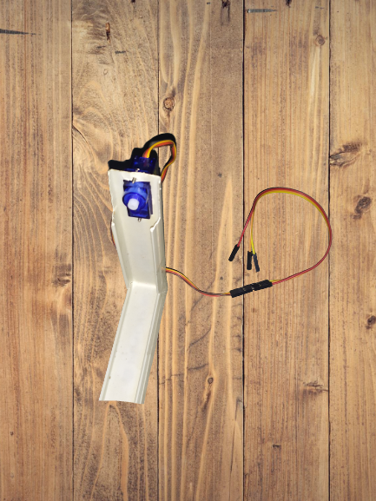
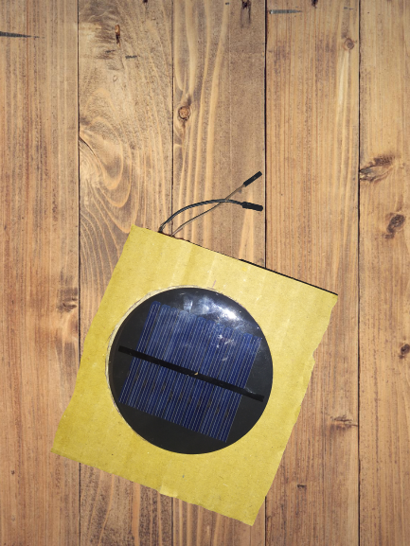
Making Of Project

